Slide 1
Ensembling TensorFlow Sequential Models with a Ridge Regressor Meta-Model

Slide 2
Introduction
Brief overview of ensemble learning in machine learning (Dietterich, 2000).
Motivation: Combining multiple models often yields better performance than any single model (Zhou, 2012).
Specific focus: TensorFlow Sequential models + Ridge regression as a meta-model.

Slide 3
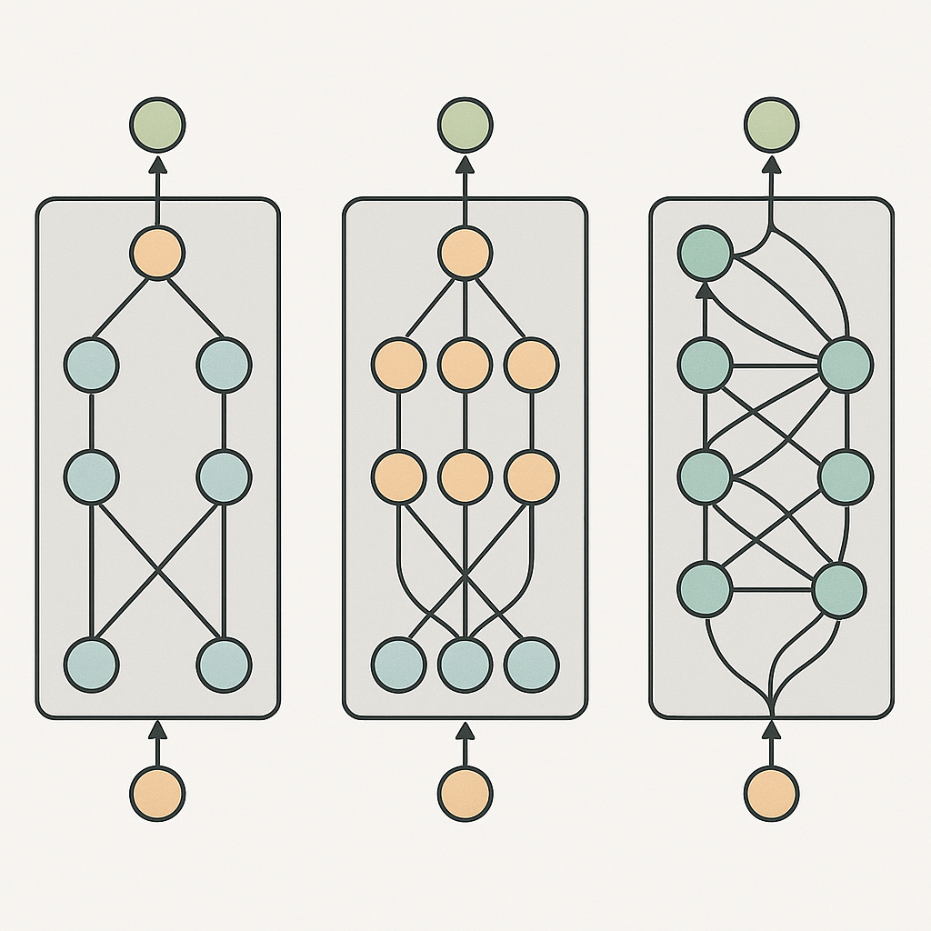
Individual Sequential Models
Definition: TensorFlow Sequential API for feed-forward architectures.
Each model can differ in:
Input window size
Number of layers/neurons
Activation functions
Reason for training individually:
Each model captures different aspects of the data distribution (Brownlee, 2020).
Encourages diversity in predictions, which is key for effective ensembling (Kuncheva, 2014).

Slide 4
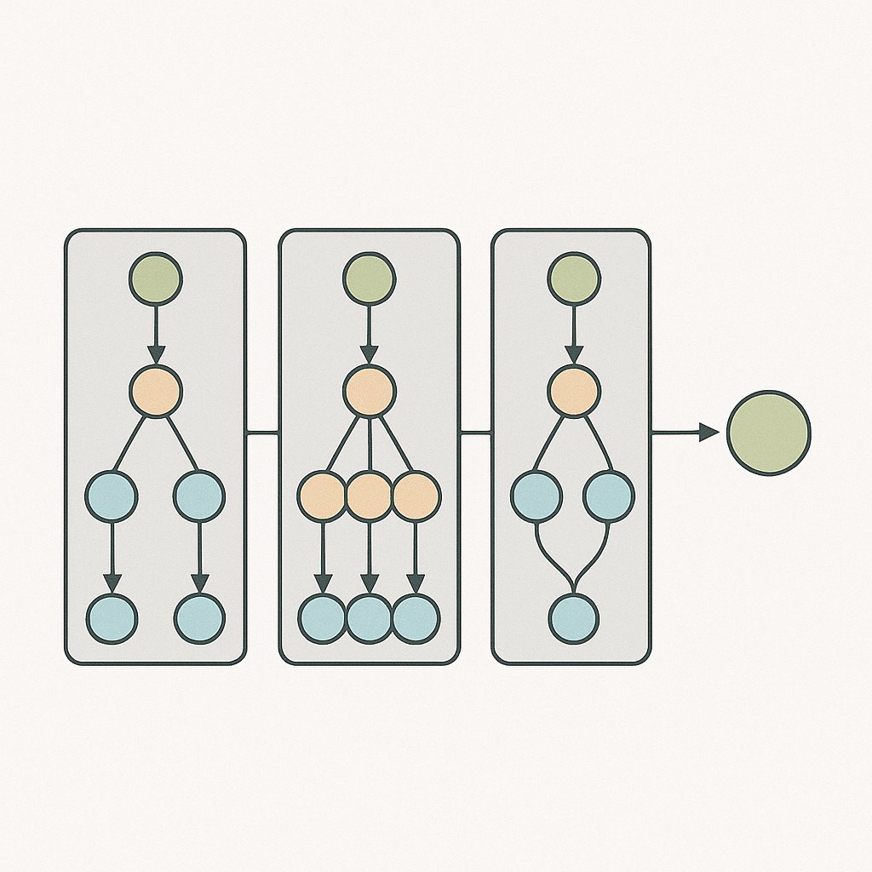
Why Ensemble?
Single models have bias/variance trade-offs (Geman et al., 1992).
Ensemble learning reduces variance and mitigates overfitting (Opitz & Maclin, 1999).
Key benefit: Leverages strengths of each model while minimizing weaknesses.

Slide 5
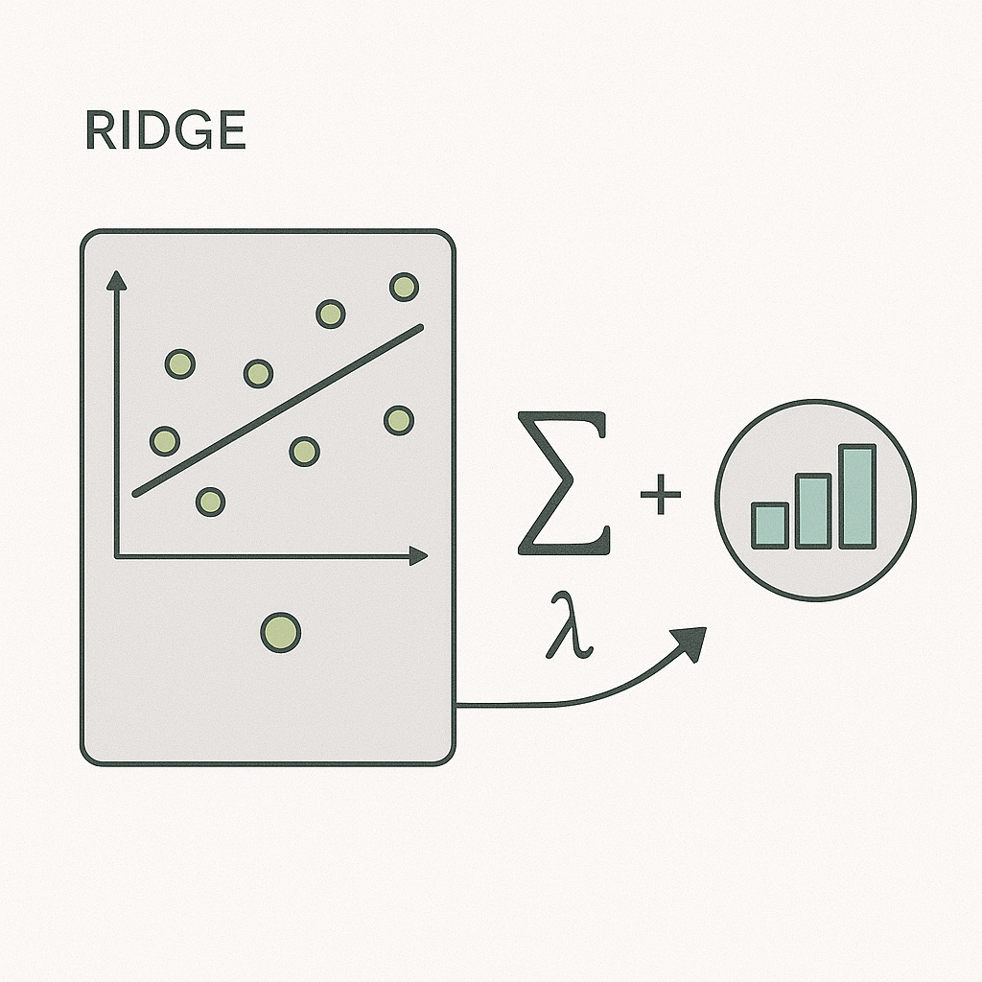
Ridge Regressor as a Meta-Model
Ridge regression = linear regression with L2 regularization (Hoerl & Kennard, 1970).
Why Ridge?
Handles multicollinearity between model predictions.
Penalizes large coefficients, preventing overfitting.
Outputs stable weights even when predictors are correlated.

Slide 6
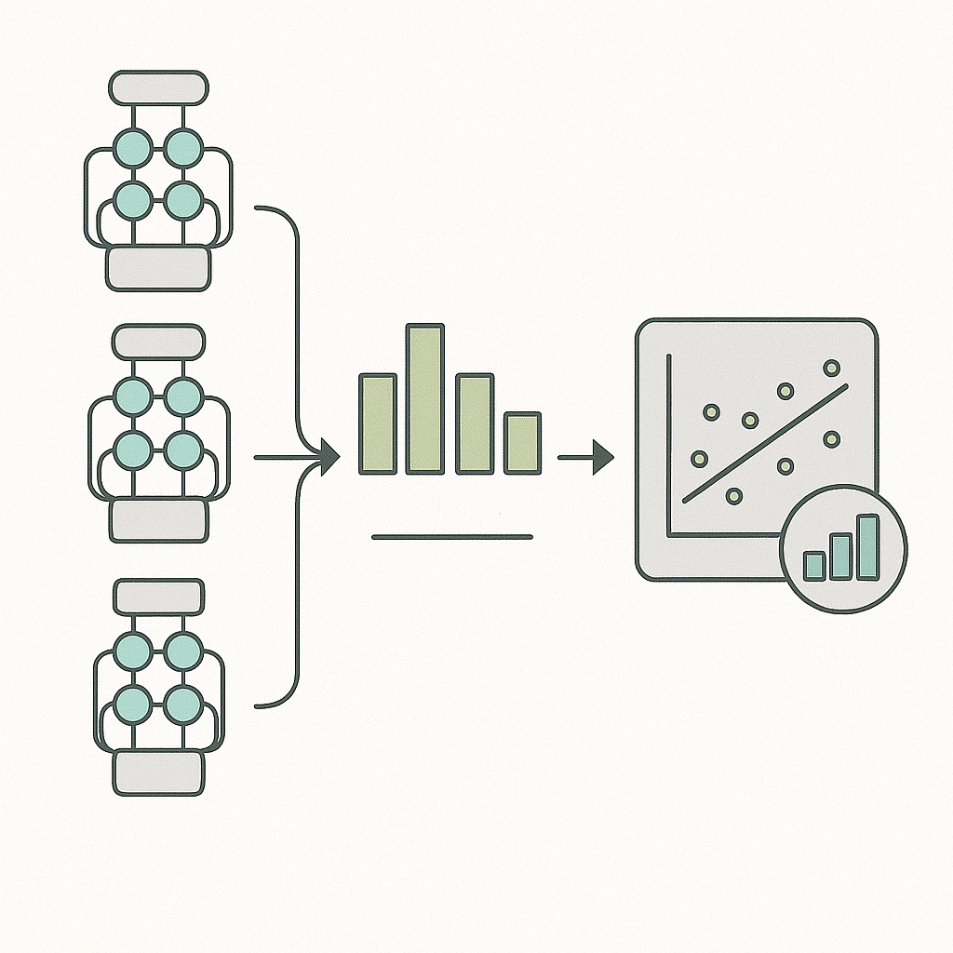
How the Meta-Model is Trained
Step 1: Train each Sequential model on training data.
Step 2: Generate predictions for a validation set.
Step 3: Feed these predictions as features into the Ridge regressor.
Ridge learns optimal blending weights that minimize error on validation predictions.

Slide 7
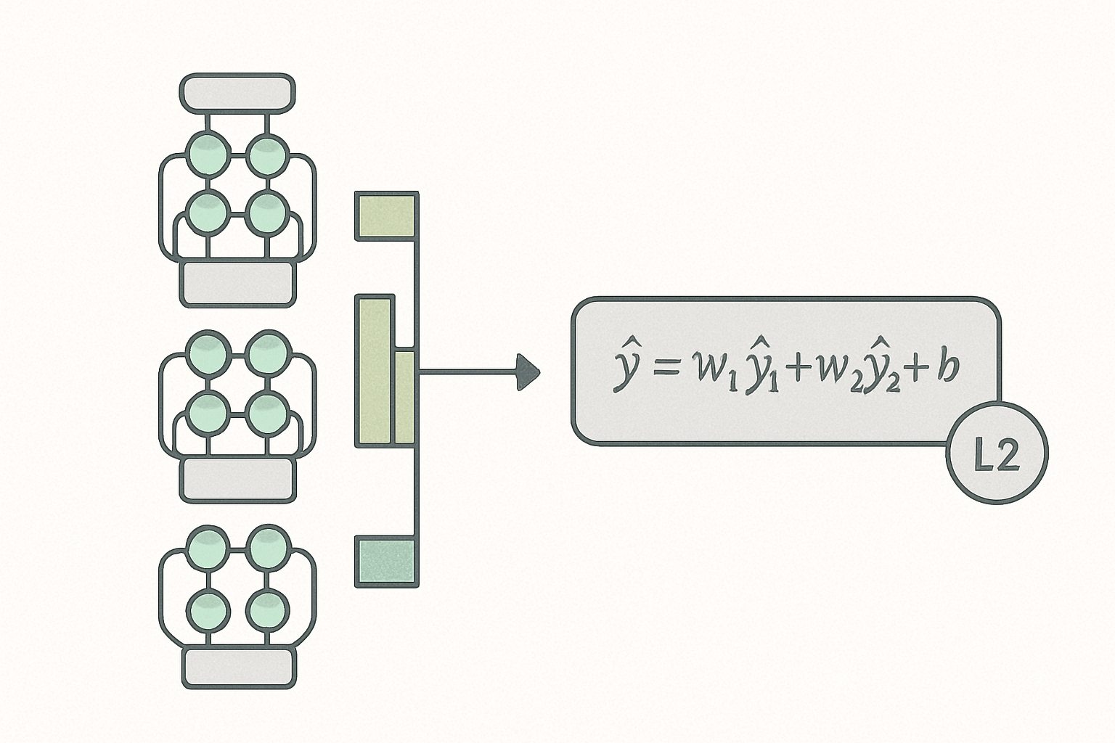
How the Ensemble Works
Meta-model learns a weight for each base model prediction.
Weighted sum produces final prediction:
L2 regularization ensures weights are not overly sensitive to noise.

Slide 8
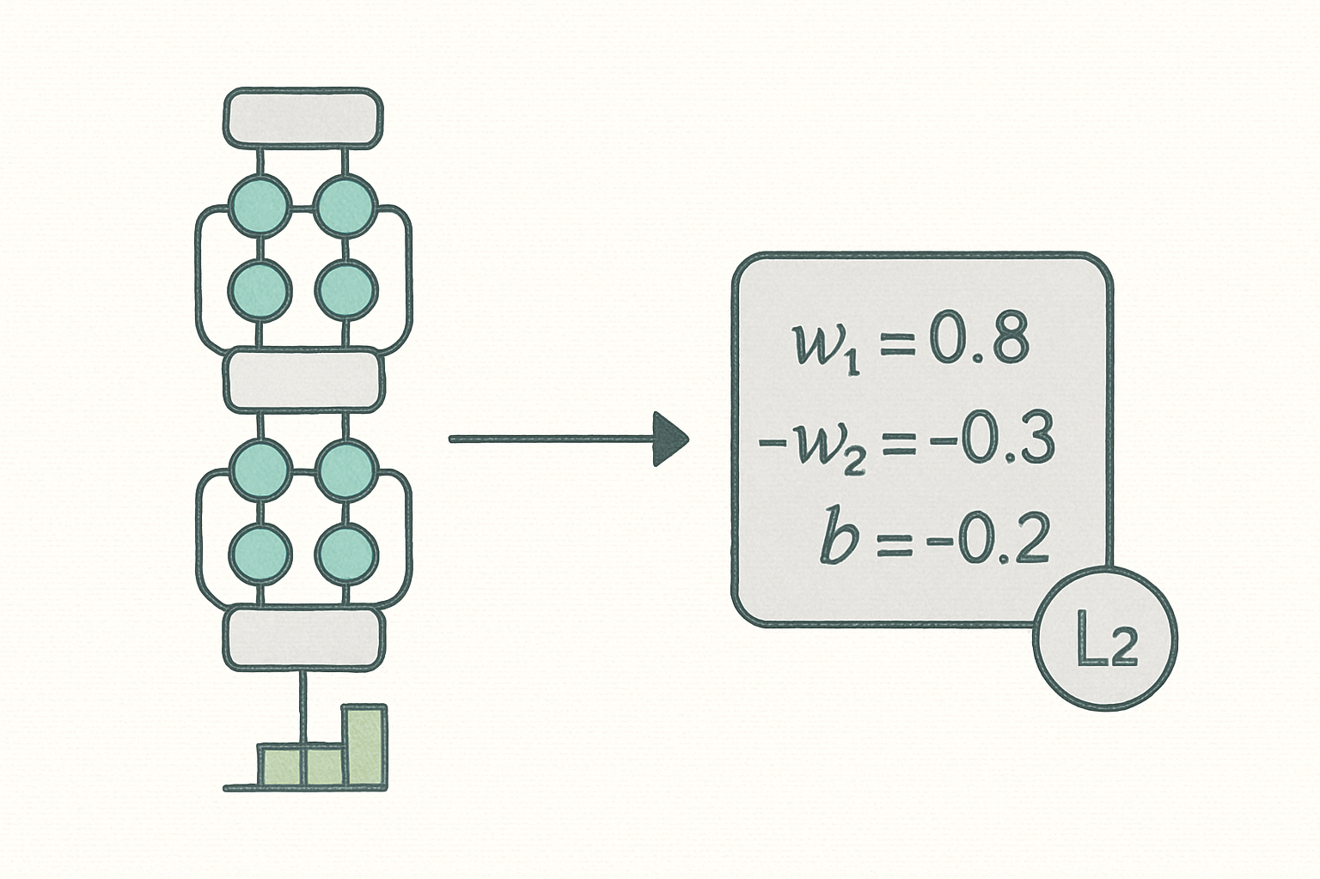
Interpreting the Meta-Model Output
Coefficients indicate the relative importance of each Sequential model.
Negative weights are possible if a model consistently predicts in the wrong direction.
The bias term adjusts for systematic offsets in predictions.

Slide 9
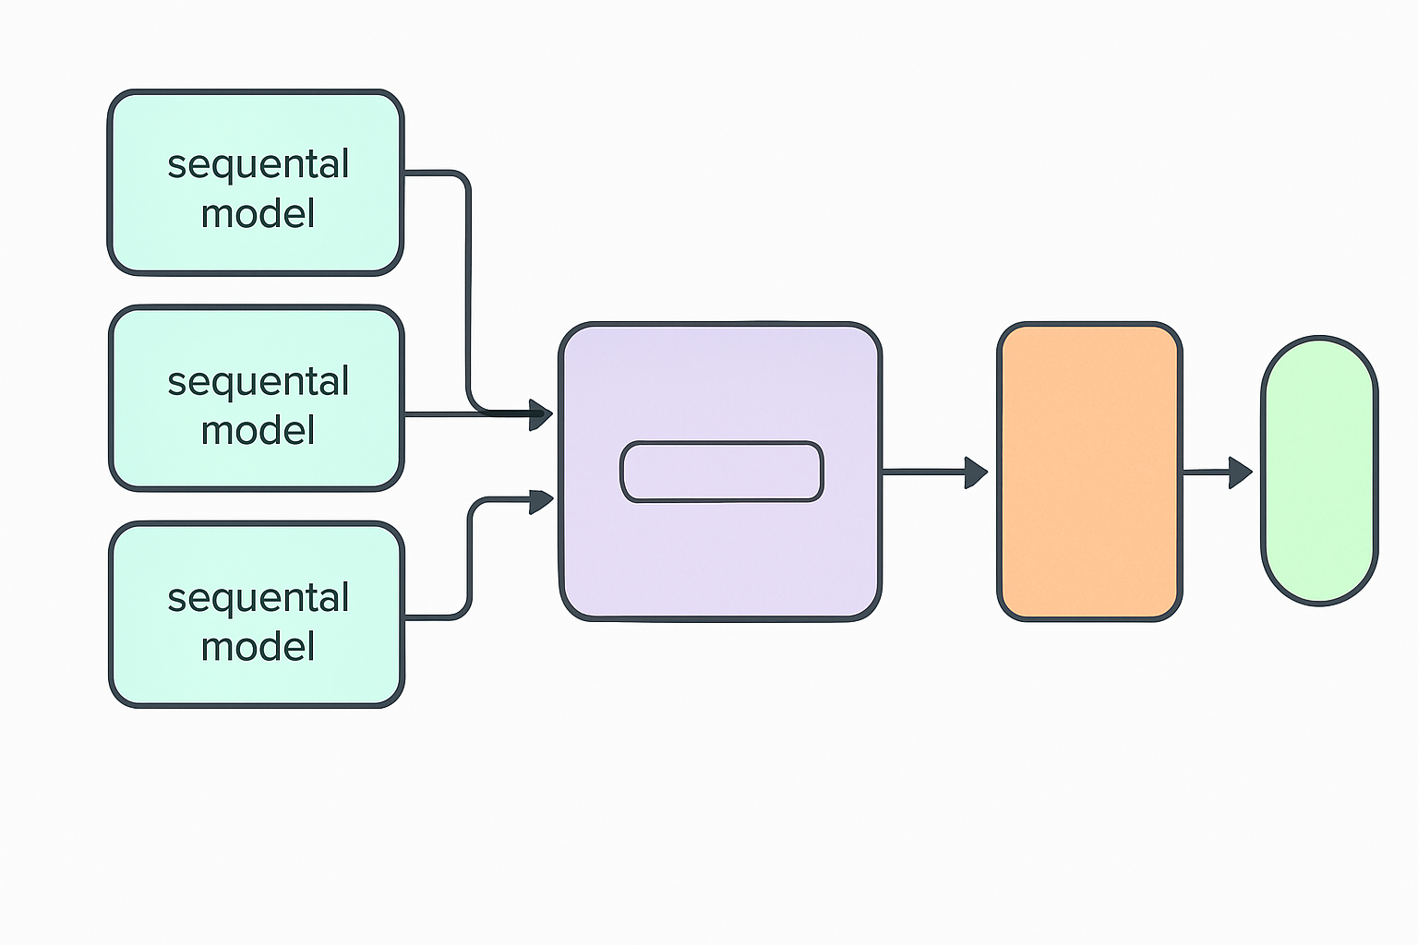
Making Predictions with the Ensemble
Process:
New input passed to each trained Sequential model.
Predictions aggregated into a vector.
Ridge meta-model applies learned weights → final ensemble prediction.
Produces a single, more accurate output.

Slide 10
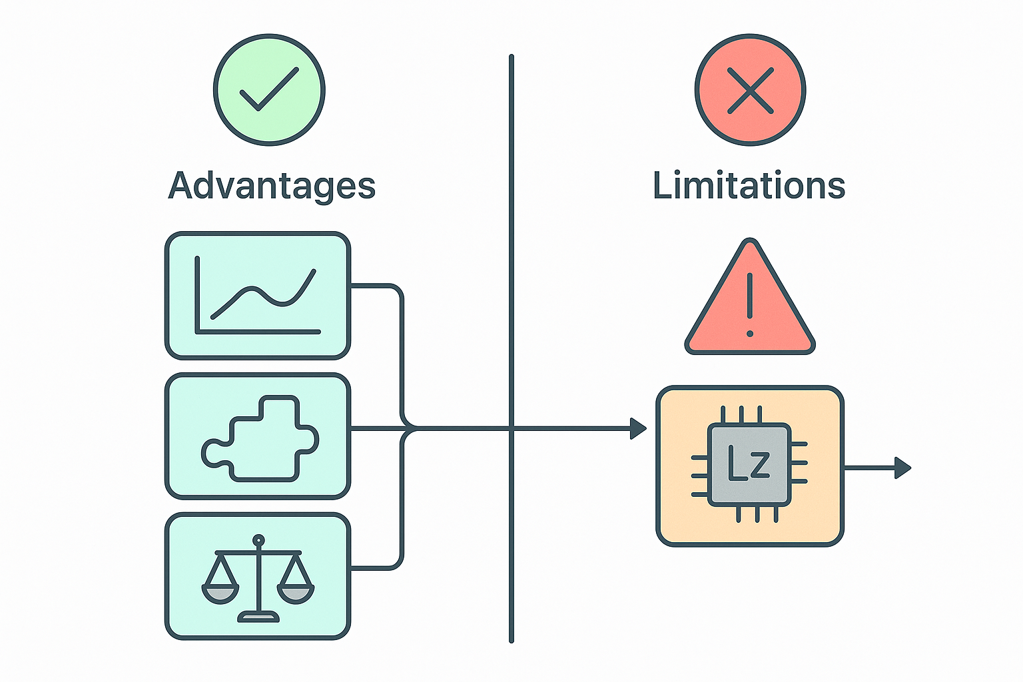
Advantages & Limitations
Advantages:
Improves accuracy and robustness.
Simple to implement after base models are trained.
Interpretable blending weights.
Limitations:
Requires careful validation split to avoid leakage.
Computational cost: training multiple models.

Slide 11
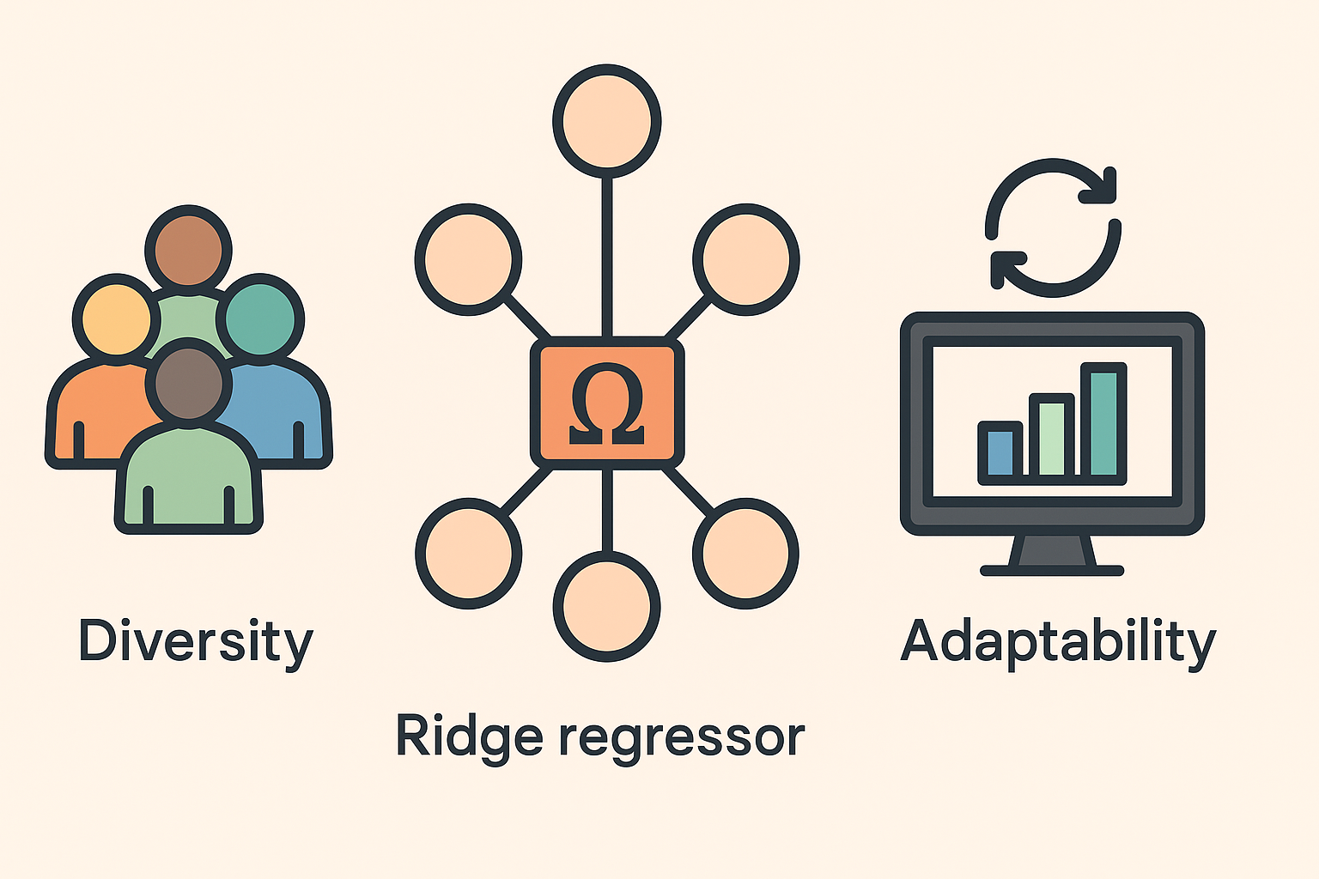
Conclusion
Ensembling leverages diversity to improve prediction accuracy.
Ridge regression meta-model efficiently combines correlated model outputs.
Approach is adaptable to many Machine Learning domains.

Slide 12
THANK YOU
References
Brownlee, J. (2020). Ensemble learning algorithms with Python. Machine Learning Mastery.
Dietterich, T. G. (2000). Ensemble methods in machine learning. Multiple Classifier Systems, 1857, 1–15. https://doi.org/10.1007/3-540-45014-9_1
Geman, S., Bienenstock, E., & Doursat, R. (1992). Neural networks and the bias/variance dilemma. Neural Computation, 4(1), 1–58. https://doi.org/10.1162/neco.1992.4.1.1
Hoerl, A. E., & Kennard, R. W. (1970). Ridge regression: Biased estimation for nonorthogonal problems. Technometrics, 12(1), 55–67. https://doi.org/10.1080/00401706.1970.10488634
Kuncheva, L. I. (2014). Combining pattern classifiers: Methods and algorithms. John Wiley & Sons.
Opitz, D., & Maclin, R. (1999). Popular ensemble methods: An empirical study. Journal of Artificial Intelligence Research, 11, 169–198. https://doi.org/10.1613/jair.614
Zhou, Z. H. (2012). Ensemble methods: Foundations and algorithms. CRC Press.
Patrick Hill
phill86037@uat.edu
August 13, 2025
Note: Illustrations were created by ChatGPT 5

